Slide 1





EARLY READING & WRITING
HATFEILD PRIMARY
SCHOOL

Slide 2





AREAS OF
LEARNING
Prime Areas
•Physical Development
•Personnal, Social, Emotional Development
•Communication and Language
Specific Areas
•Literacy
•Mathematics
•Understanding of the World
•Expressive Arts and Design

Slide 3

PRE-READING AND WRITING SKILLS
01
Motivation to Read
02
Language skills
What Can Parents Do?
•Let your child pick what book they want to read.
•Read to your child everyday.
•Read with enthusiasm.
•Model you are a writer
Concepts of Print
In order to learn how to read and write, children must understand how books work.
Children need to have language skills before learning how to read and write so they can describe things and share their knowledge and ideas.
What Can Parents Do?
•Ask your child open-ended questions such as, “What do you think will happen next?” “How do you think … is feeling?”
•Ask your child to retell the story in their own words. You could use props.
•Encourage your child to make up their own stories. Scribe their stories. This can become a record of their language development, story writing development, their imagination and sometimes their understanding
of the world (depending on the content of the story).

Slide 4



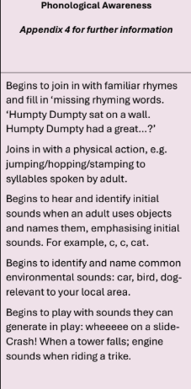
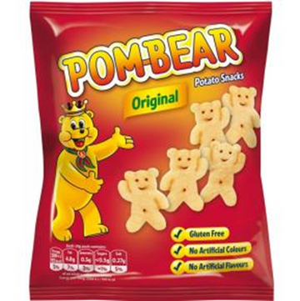


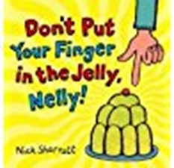
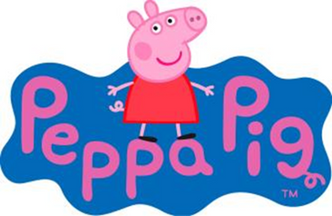
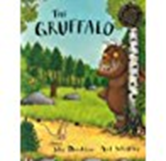


EARLY PRINT
Age 2 - 3
Understanding Print Carries Meaning
Children from an early age begin to recognise print without realising. They recognise their favourite TV show and their favourite snacks.
Rhyme
Rhyming requires listening closely to words and playing with those sounds.
Without even realising it, children
are training their ears to pick up on sounds and reproduce
them when they engage in rhyme activities.

Slide 5
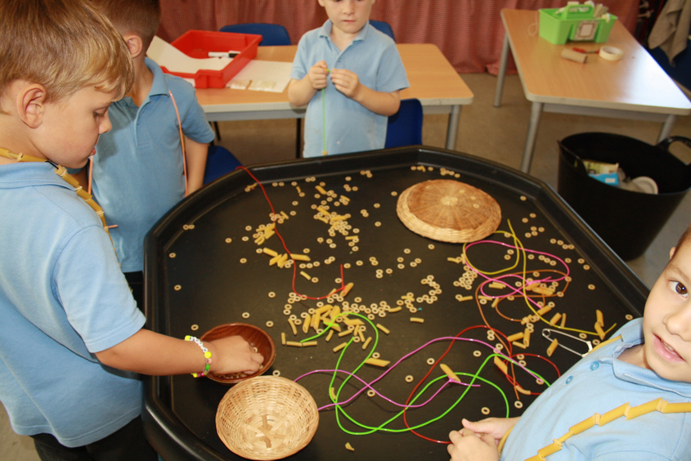
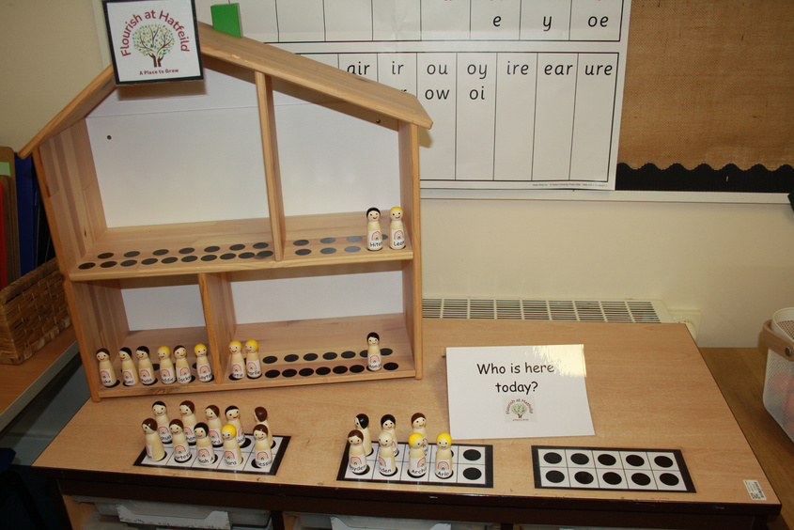
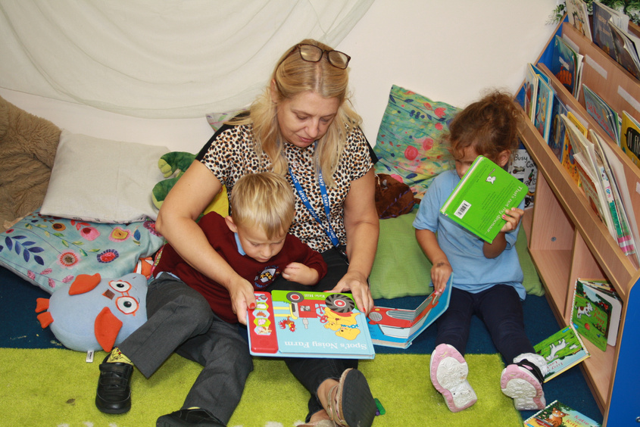
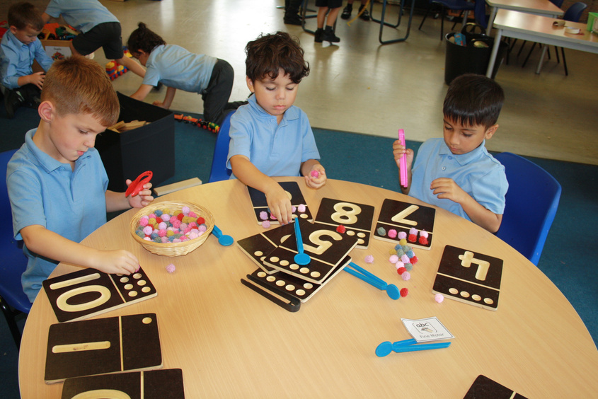

COMMUNICATION AND LANGUAGE
Developing strong oracy skills in children aged 2 to 6 is not merely beneficial for communication; it is a fundamental prerequisite for their successful
journey into written language. Oracy, encompassing a child's ability to speak, listen, understand, and express themselves effectively, lays the entire
cognitive and linguistic groundwork upon which writing proficiency is built. Without a robust oral language foundation, learning to write becomes a
significantly more challenging and often frustrating endeavour.
Beyond individual words, oracy helps children internalise the structures of language. Through hearing and using grammatically correct sentences,
they develop an intuitive understanding of syntax. When a child consistently hears and practices constructing sentences orally, they are
simultaneously building the mental blueprints for how sentences should be organised in written form.
At its core, writing is the act of transcribing thoughts, ideas, and stories onto paper. Before a child can effectively translate these into written form, they
must first be able to formulate them verbally. This process begins with a rich and expansive vocabulary. Children who are exposed to a wide range of
words through conversations, storytelling, and active listening will have a larger mental lexicon to draw upon when they begin to write. They
understand the nuances of word meanings, enabling them to choose appropriate words to convey their intended message, even if initially through emergent writing (scribbles, mock letters).
Before children can write their own stories, they typically tell them. Engaging in imaginative play, recounting daily events, and participating in shared storytelling activities help children develop a sense of plot, character, setting,
and sequence. These narrative structures, first practiced through spoken language, provide the scaffolding for creating written narratives. The ability to
sequence events logically and develop characters orally directly translates into the capacity to organise a written story.

Slide 6

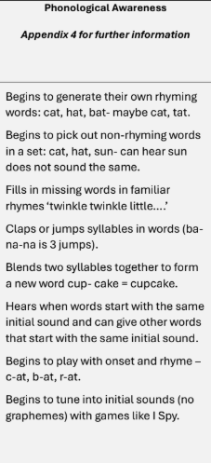
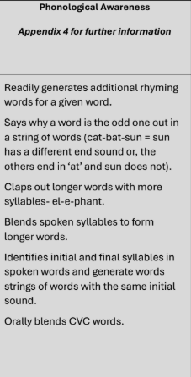
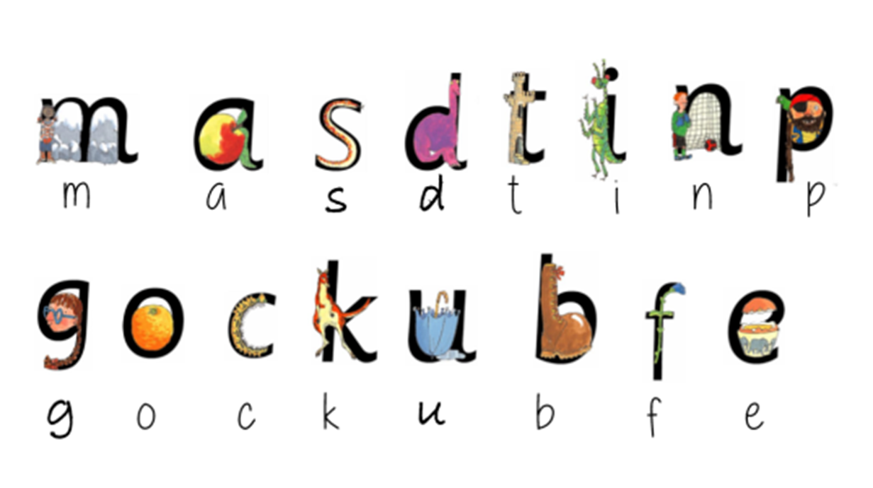
EARLY PHONICS
3 - 4
4 - 5
Notes:
Why phonological awareness is important:
• Prepares for reading and writing: Phonological awareness helps children recognise and manipulate the sounds of language, which is
fundamental for understanding how letters and sounds work together in words (phonics) and for later decoding and spelling.
• Develops oral blending and segmenting: Children learn to blend sounds together to form words (/p/ /e/ /n/ = /pen/) and to segment words into
individual sounds (/pen/ = /p/ /e/ /n/), which are vital skills for both reading and spelling.
• Improves literacy skills: Strong phonological awareness is a strong predictor of later reading achievement and supports children in developing
automaticity in reading and effective spelling skills.
• Supports learning in Key Stage 1: By building strong phonological awareness in the early years, children are better equipped to engage with
the systematic synthetic phonics programs typically introduced in Key Stage 1, ensuring they have the necessary auditory and manipulative
skills for decoding and encoding text.
• Enhances language development: Beyond reading and writing, phonological awareness contributes to a child's overall understanding of
language structure and the ability to distinguish sounds, which positively impacts spoken language development and comprehension.

Slide 7


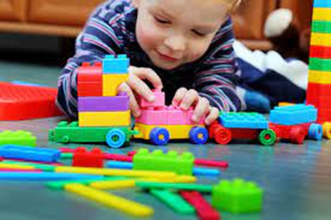
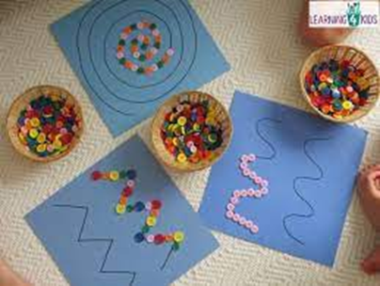
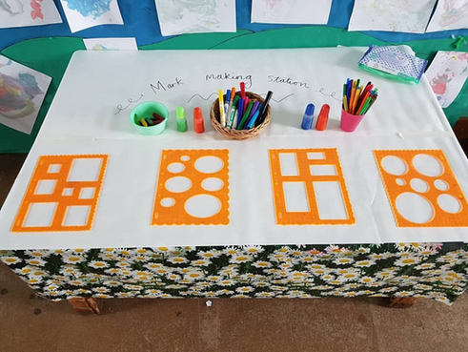
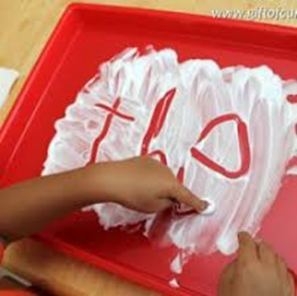
PRE-
WRITING
Pre-writing skills are crucial for developing foundational abilities like fine motor control, hand-eye coordination, and visual perception, which are essential for future handwriting and overall academic success. These skills involve learning to grasp a pencil correctly and master basic strokes such as vertical and horizontal lines, circles, and crosses, which form the building blocks for letters and numbers.
Notes:
Activities to do at home:
Wet Dry Try Method
Take a chalk board and make the shape on the board. Provide the child with a slightly wet/damp sponge and demonstrate and then ask them to ‘wet’ along/around the shape using their sponge. They should hold this between their thumb and index finger.
The sponge should be about the size of the box shown here, any bigger it will be hard for the child to hold it between his/her thumb and index finger.
Now provide the child with a dry piece of cloth of the same size and ask the child to dry along/around the shape they have just wet. Demonstrate this first.
Now ask the child to try drawing the same shape on the chalkboard.
The Handwriting without tears Wet, Dry, Try app can also be used.
Drawing lines in different textures: sand, rice, shaving-foam, finger-paint, hand cream, talcum-powder or gloop (corn flour and water mixture)
Put texture to be played with into the tray and encourage lines to be made with index finger of preferred hand; if there is no clear dominant hand allow either index finger to be used. Perhaps use a vertical surface such as a window or mirror. Remember to use the boundaries to help to make the shape. If you are able, repeat this activity with a couple of the textures. The more varied ways that a child ‘makes’ these shapes, the more chance they have of remembering it.
Ways of practising a circular movement:
Make a cake holding the bowl with one hand and stirring in a circular motion with the other hand. Draw in the air in an anti-clockwise movement with a scarf, long ribbon, paper-towel roll. Sing whilst doing action: ‘Draw a circle in the air, in the air. Draw a circle in the air, in the air. Draw a circle in the air and leave it hanging there, draw a circle in the air in the air.’
Ways of making lines without drawing them:
Using material such as string, playdoh, plasticine and make the shapes or even lay the material over pictures of the shapes. Have him/her roll a car on a mat or picture of the shapes; drive the car along the roads and around the roundabouts on the mat. Try to ensure he/she does not move his/her body from one side of the mat to another, but rather uses his/her ‘driving’ hand in a variety of positions and crosses in front of their body.
Different ways to draw lines:
Have him/her paint the fence, wall or paving-slabs with water and a paintbrush.
Draw lines on different textures and in different plane (vertical and horizontal)
Use a variety of writing implements: pencil, crayons, wax crayons, chunky chalks, ordinary chalks, whiteboard markers, felt-tip pens, paintbrush, crayons. Try different textures to draw/paint on: sugar paper, chalkboard, pavement, bubble wrap, side of the bath, sandpaper, on long strips of lining wallpaper. Make the shapes out of sandpaper and mount on cardboard. Demonstrate and then ask the child, to run their index finger over the shape to ‘feel’ it.
Rainbow letters:
Adult draws a letter in one chalk colour, child copies in another colour, then repeat with other colours.

Slide 8
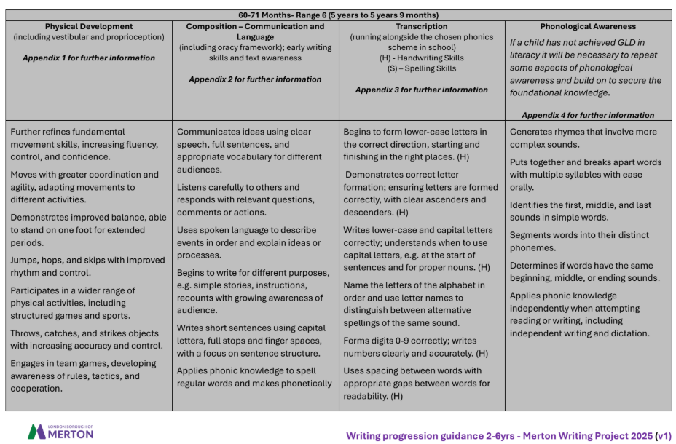
END OF RECEPTION
Notes:
Phonological Awareness for 48-60 Months - what we focus on in Reception:
Rhyme:
• Generating multiple rhyming words: Children can readily generate several rhyming words for a given word.
• Identifying and explaining non-rhyming words: They can not only identify the odd one out but also explain why it does not rhyme.
• Creating simple rhyming sentences or phrases: They might start to create short, silly phrases using rhyming words. The fat cat sat on a mat.
Syllable Awareness:
• Segmenting multi-syllabic words: They can clap out or count syllables in longer words, e.g. ‘el-e-phant’- three syllables.
• Syllable sorting (simple): You can have two boxes labelled with pictures representing one syllable (a sun) and two syllables (an apple). Ask the
child to put picture cards of familiar objects into the correct box based on the number of syllables.
• Blending syllables in longer words: They can blend spoken syllables to form longer words.
• Deleting syllables: They can identify the word that remains when a syllable is removed, e.g. "Say 'cowboy'. Now say it without 'boy'." - "cow".
Phoneme Awareness (focus on initial and final sounds):
• Identifying the first sound (initial phoneme): They can consistently identify the first sound in a word. "What's the first sound in 'dog'?" - /d/.
• Identifying the last sound (final phoneme): They can identify the last sound in a word e.g. "What's the last sound in 'cat'?" - /t/.
• Matching words with the same beginning or ending sound: They can match pictures or objects based on whether their names start or end
with the same sound.
• Producing words starting with a given sound: They can generate words that begin with a specific sound.
Beginning sound blending and segmentation (simple CVC words):
• Blending onset and rime: They can blend the initial consonant sound (onset) with the vowel and final consonant sound (rime) to form simple
CVC (consonant-vowel-consonant) words e.g. ‘/c/... /at/’ – ‘cat’; ‘/s/... /un/’ – ‘sun’.
• Segmenting the first sound in CVC words: They can identify the first sound in a simple CVC word.
Sound Discrimination:
• Identifying minimal pairs: They can distinguish between words that differ by only one sound, e.g. cat and hat, pig and big.
Important considerations:
• Explicit instruction: While play-based learning is still crucial, you can introduce more explicit activities that focus on specific sounds.
• Visual and auditory cues: Using pictures, objects, and clear pronunciation helps children understand the concepts.
• Gradual progression: Build on previously learned skills.
• Connection to early literacy: Begin to link phonological awareness to early reading by showing how sounds relate to letters (though the focus
remains auditory at this stage).
• Individual differences: Children will progress at different rates. Provide support and challenge as needed.
• Keep it engaging: Use a variety of activities, games, and songs to maintain interest.

Slide 9
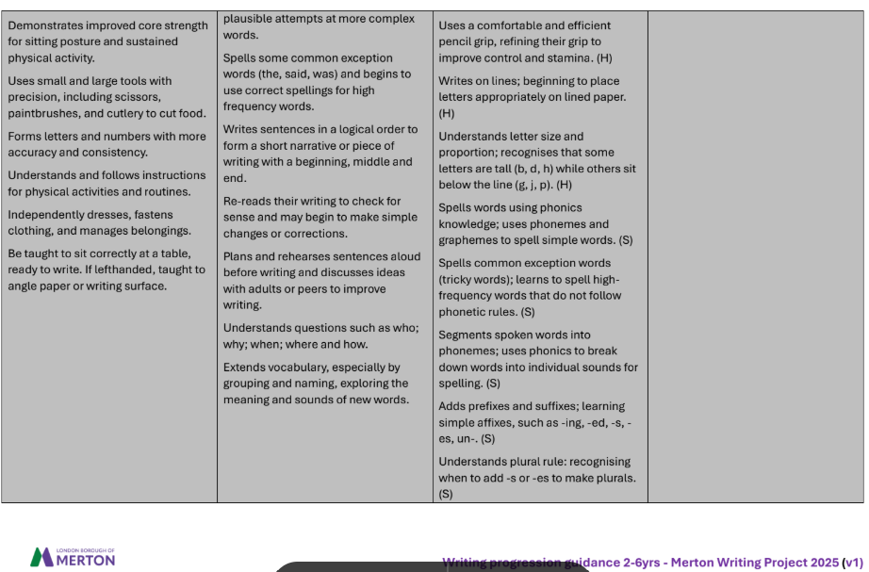
END OF RECEPTION

Slide 10
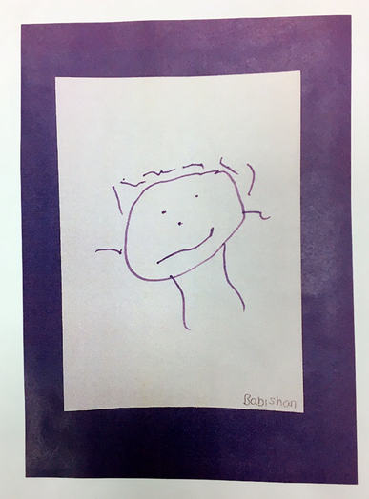
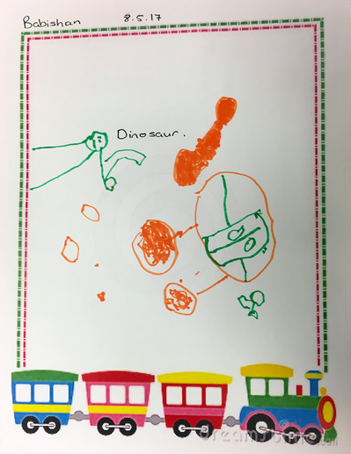
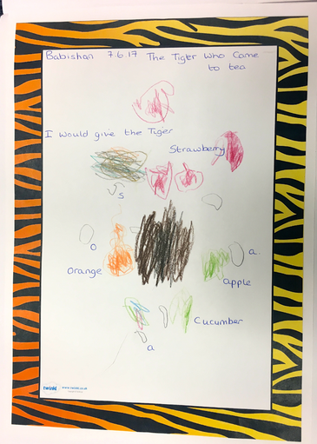
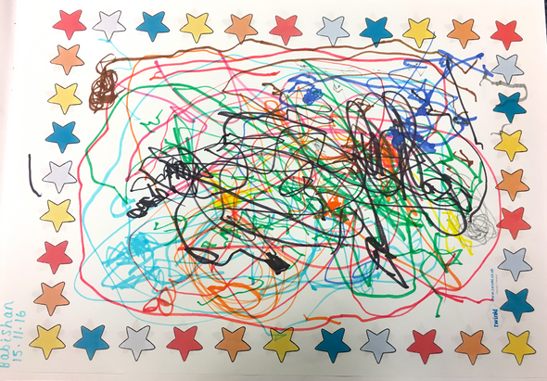
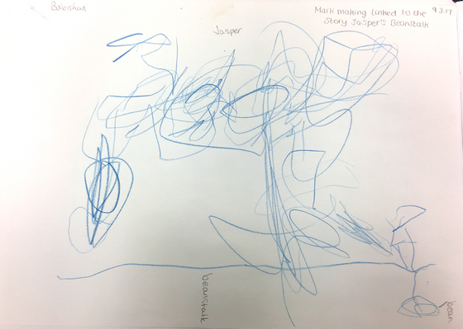
STAGES OF EARLY
WRITING

Slide 11
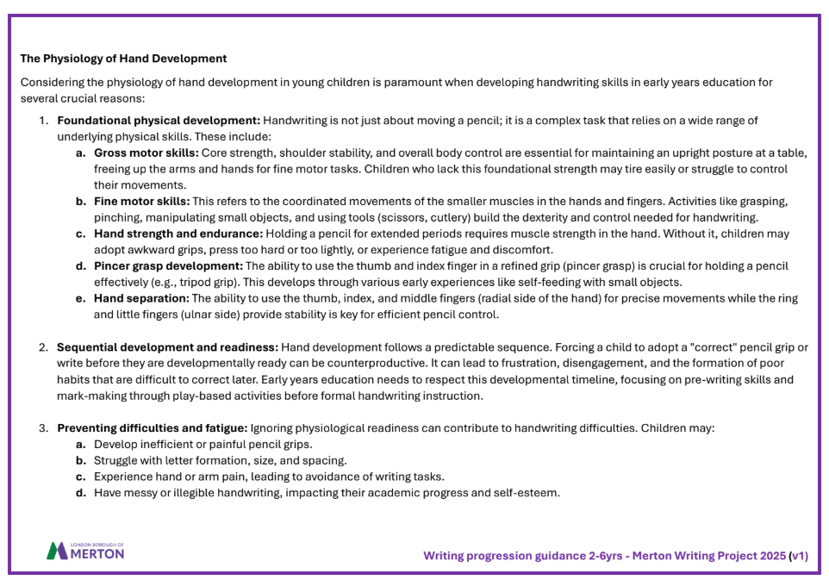
HAND DEVELOPMENT
Notes:
The importance of working on vertical surfaces when developing handwriting
Children benefit from working on vertical surfaces because these activities enhance fine and gross motor skills, improve core strength and posture,
and support better handwriting and visual-motor integration.
Specific benefits of vertical surface work:
• Enhanced motor skills: Working on vertical surfaces, like chalkboards or easels, encourages larger arm movements, strengthening the
shoulder, elbow, and wrist muscles, which are crucial for various activities including handwriting.
• Improved core strength and posture: Engaging in activities on vertical surfaces in a standing or kneeling position forces children to activate
their core and back muscles to maintain an upright posture, leading to improved core stability and balance.
• Handwriting development: Vertical surfaces naturally promote wrist extension and a more stable wrist position, which is important for
developing proper pencil grasp and control, essential for fluid writing.
• Bilateral coordination and midline crossing: Tasks like holding paper while drawing or painting on a vertical surface require the use of both
hands, promoting bilateral coordination. Reaching across the surface also naturally encourages midline crossing, strengthening the
communication between the left and right hemispheres of the brain, which benefits various motor skills like tying shoelaces or reading.
• Visual-motor integration and attention: The proximity of the work to the child's eyes on a vertical surface can improve hand-eye coordination
and help children who struggle with visual attention, as they have a better view of their actions and can better track movements.
• Spatial awareness and directionality: Understanding directional terms (up, down, left, right) becomes more intuitive when children can relate
these words to their own movements on a vertical surface.
• Increased movement and reduced fidgeting: Vertical surfaces can be beneficial for children who work better standing or in a less sedentary
position, offering a change of position that can improve focus and engagement.

Slide 12
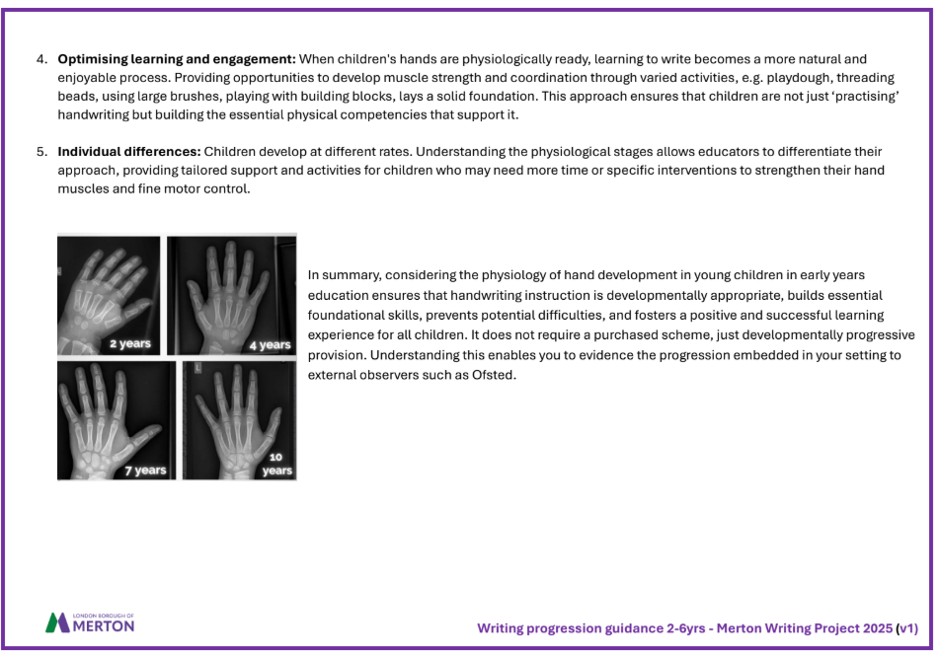
HAND DEVELOPMENT

Slide 13
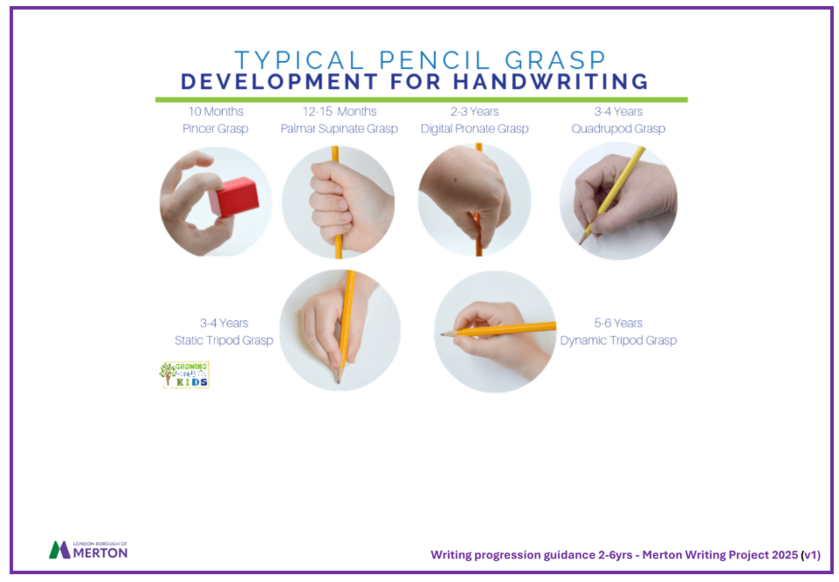
HAND DEVELOPMENT
Notes:
The importance of working on vertical surfaces when developing handwriting
Children benefit from working on vertical surfaces because these activities enhance fine and gross motor skills, improve core strength and posture,
and support better handwriting and visual-motor integration.
Specific benefits of vertical surface work:
• Enhanced motor skills: Working on vertical surfaces, like chalkboards or easels, encourages larger arm movements, strengthening the
shoulder, elbow, and wrist muscles, which are crucial for various activities including handwriting.
• Improved core strength and posture: Engaging in activities on vertical surfaces in a standing or kneeling position forces children to activate
their core and back muscles to maintain an upright posture, leading to improved core stability and balance.
• Handwriting development: Vertical surfaces naturally promote wrist extension and a more stable wrist position, which is important for
developing proper pencil grasp and control, essential for fluid writing.
• Bilateral coordination and midline crossing: Tasks like holding paper while drawing or painting on a vertical surface require the use of both
hands, promoting bilateral coordination. Reaching across the surface also naturally encourages midline crossing, strengthening the
communication between the left and right hemispheres of the brain, which benefits various motor skills like tying shoelaces or reading.
• Visual-motor integration and attention: The proximity of the work to the child's eyes on a vertical surface can improve hand-eye coordination
and help children who struggle with visual attention, as they have a better view of their actions and can better track movements.
• Spatial awareness and directionality: Understanding directional terms (up, down, left, right) becomes more intuitive when children can relate
these words to their own movements on a vertical surface.
• Increased movement and reduced fidgeting: Vertical surfaces can be beneficial for children who work better standing or in a less sedentary
position, offering a change of position that can improve focus and engagement.

Slide 14
PRESENTATIONS
THANKS FOR
WATCHING

