Slide 1

2024-2025
Reception

Slide 2


Phonics
3
4
Evidence Me
Timetables
5
2
Curriculum
6
1
Key dates for the future
Who’s who
Agenda 2024-25

Slide 3
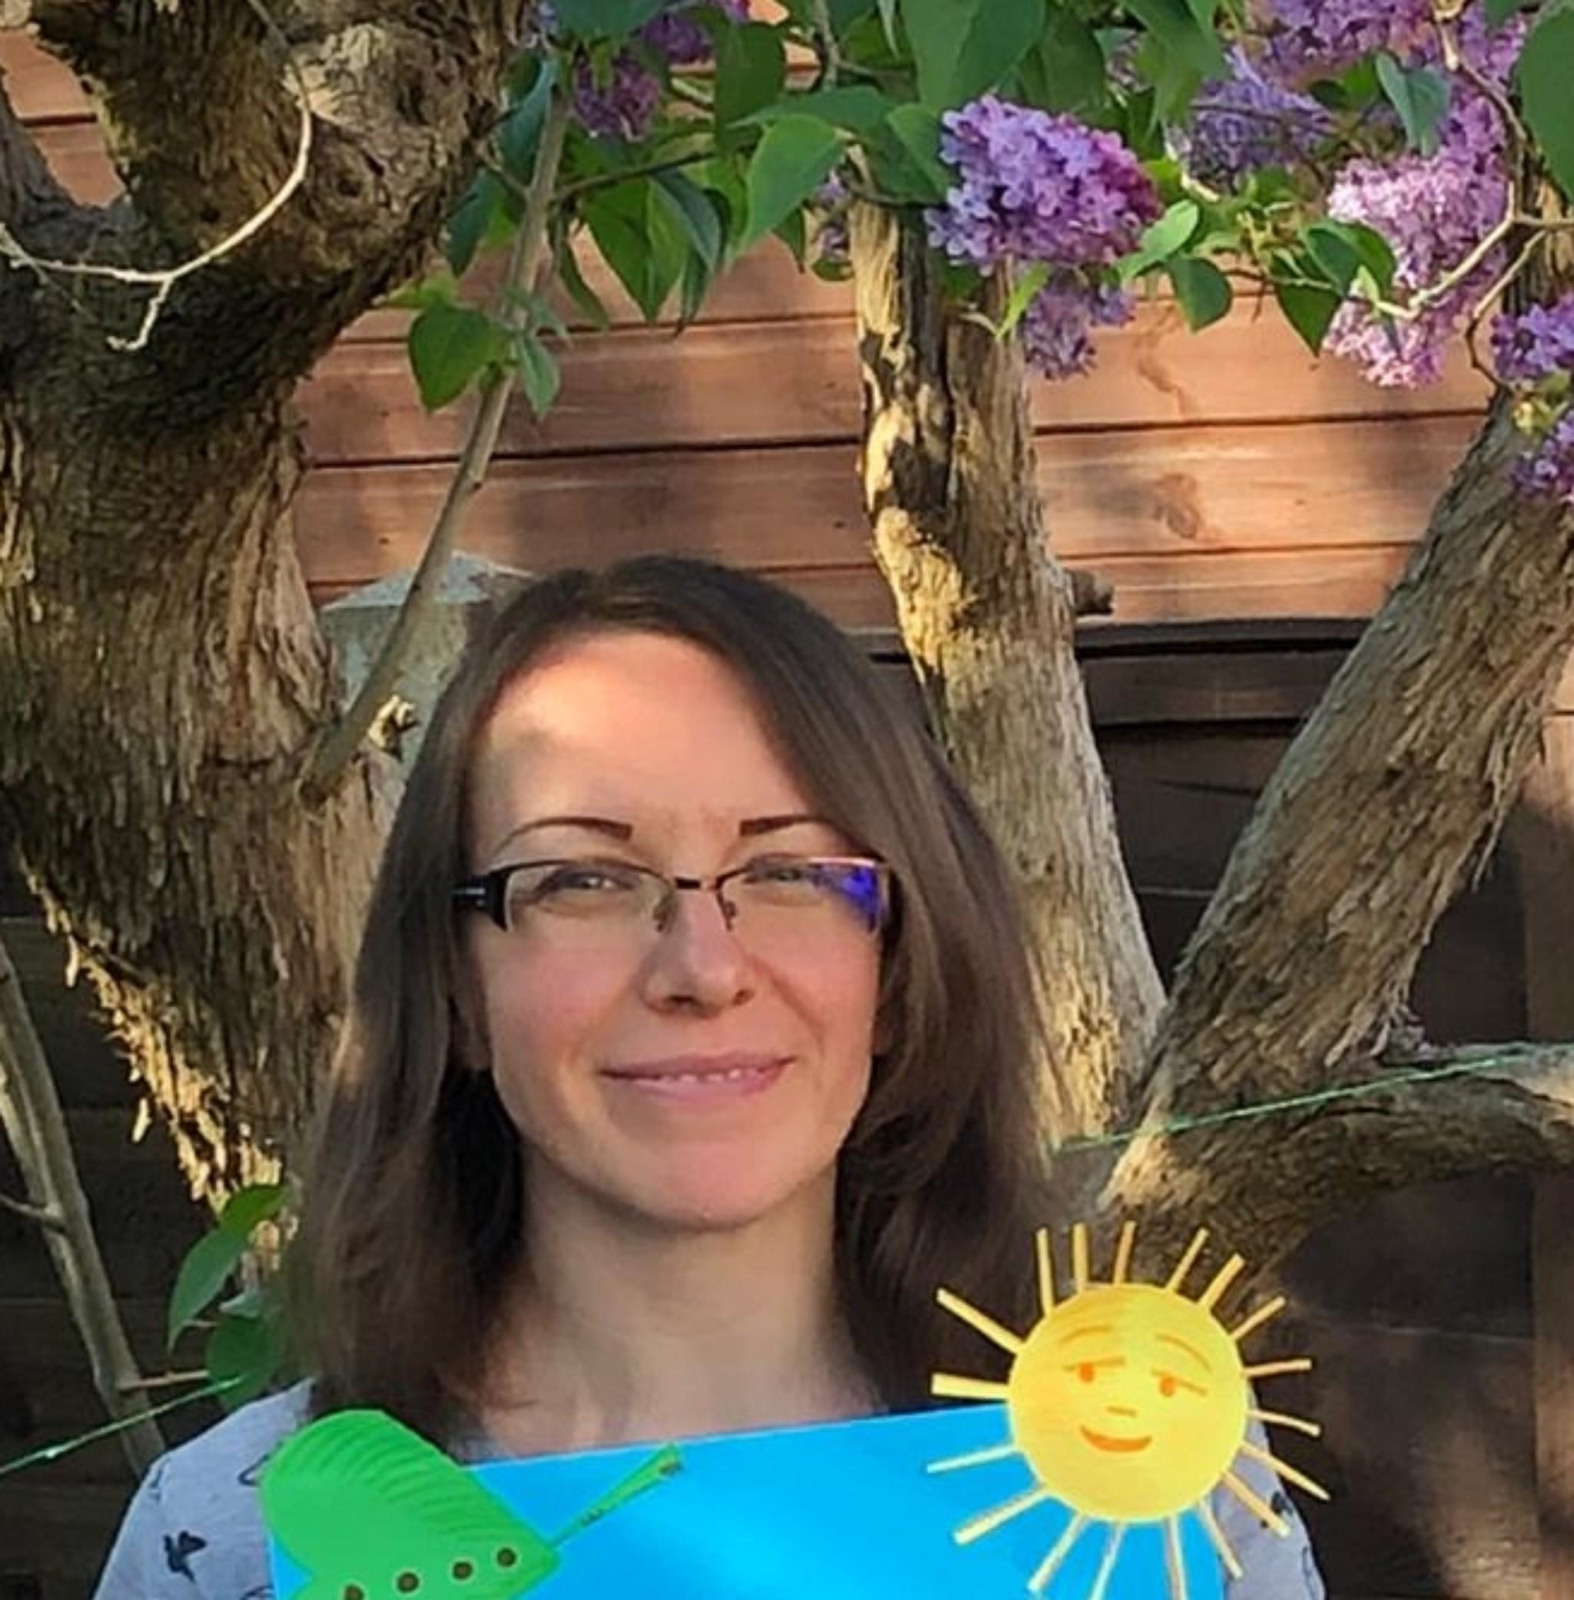
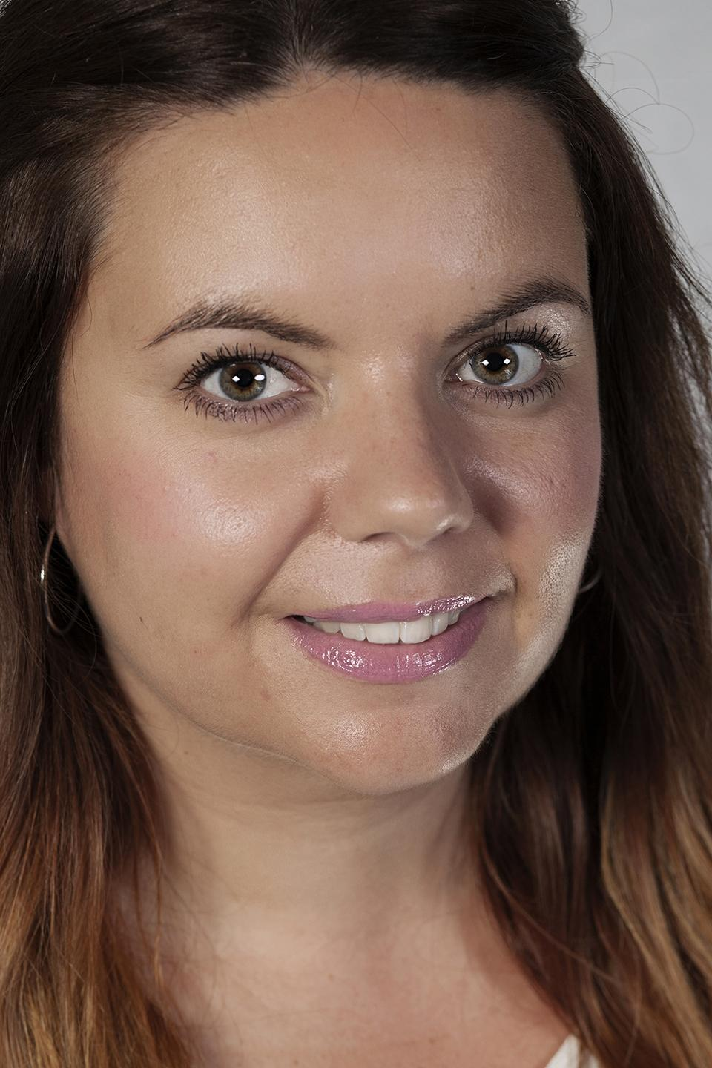
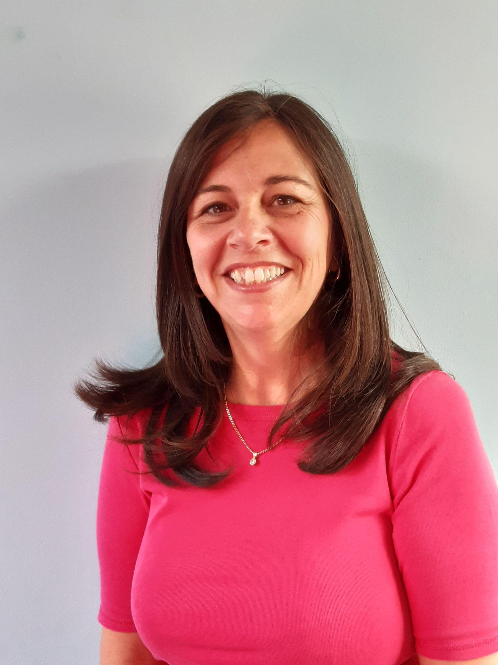
Staff in Reception
1
Who’s who
Class Teacher
Mrs Best- Carragher Mon-Wed
Class Teacher
Miss Baker
Wed-Fri
Teaching Assistant
Mrs Ventham
All Week

Slide 4
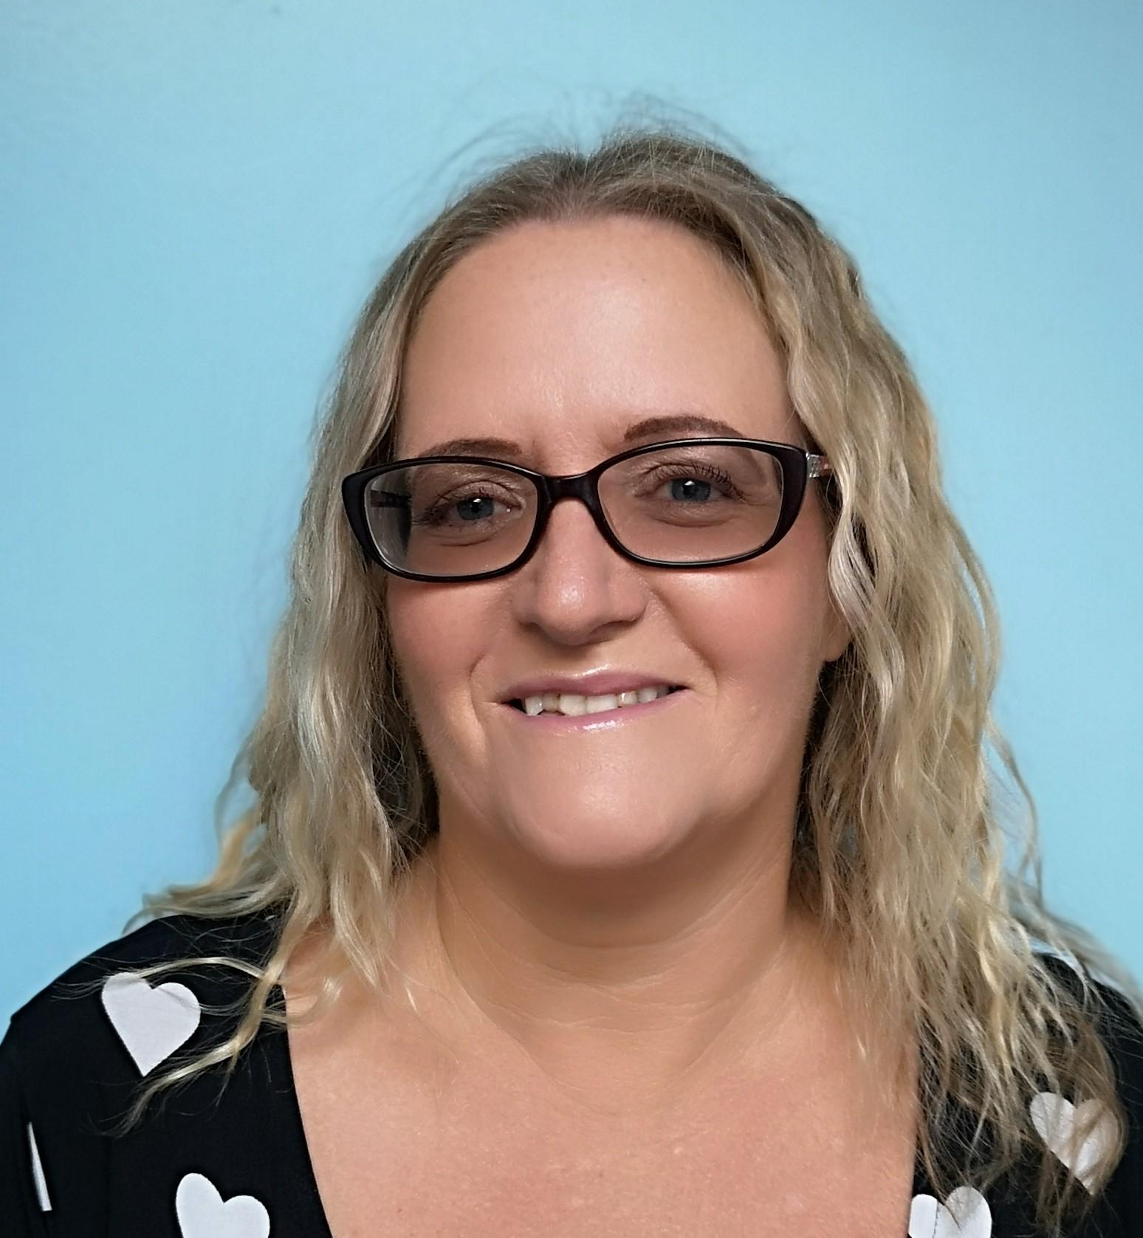
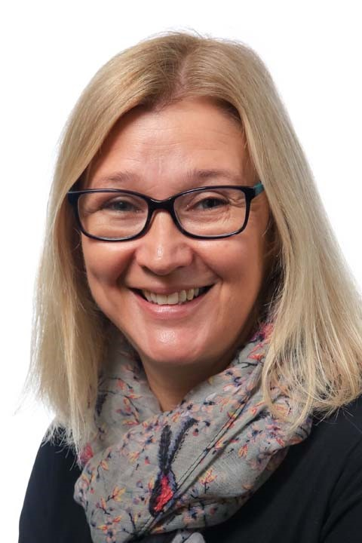
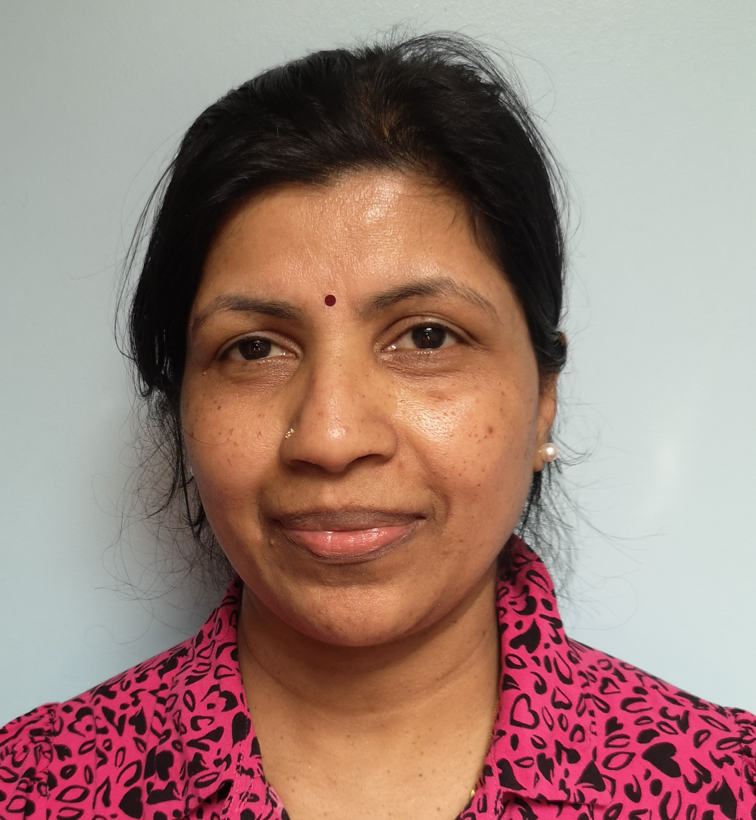
1
Cover Teacher and Lunch Time staff
Who’s who
Mrs Kember PPA Cover Teacher
Mrs Panners
Lunch Time
Mrs Jegatheeswarran
Lunch Time

Slide 5
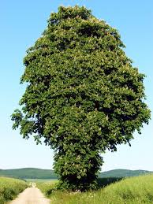
1
Who’s who
Your child is in Chestnut Class
Chestnut Class- Mrs Best- Carragher and Miss Baker

Slide 6
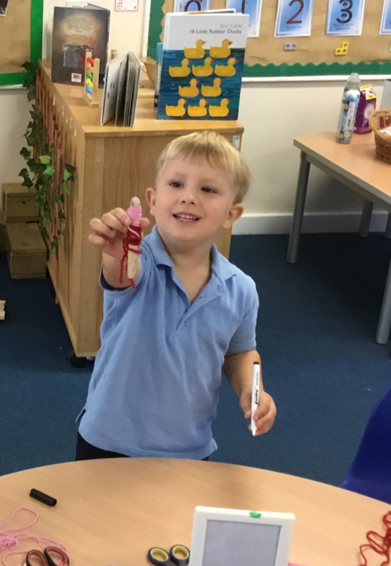
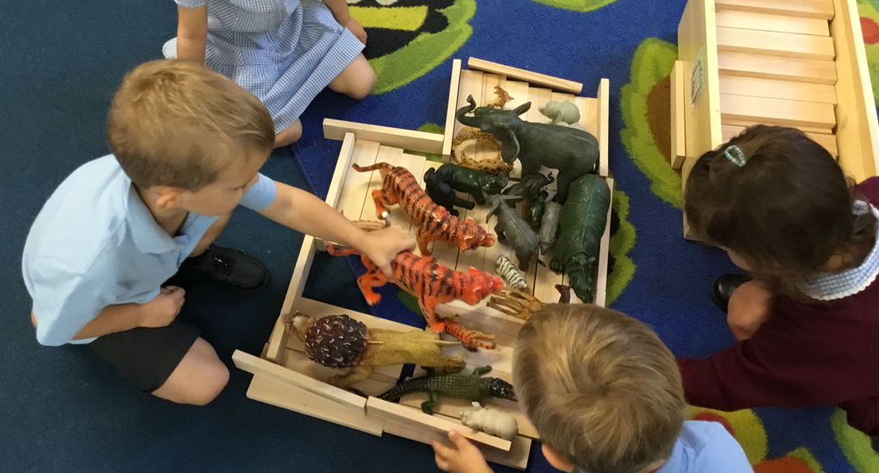
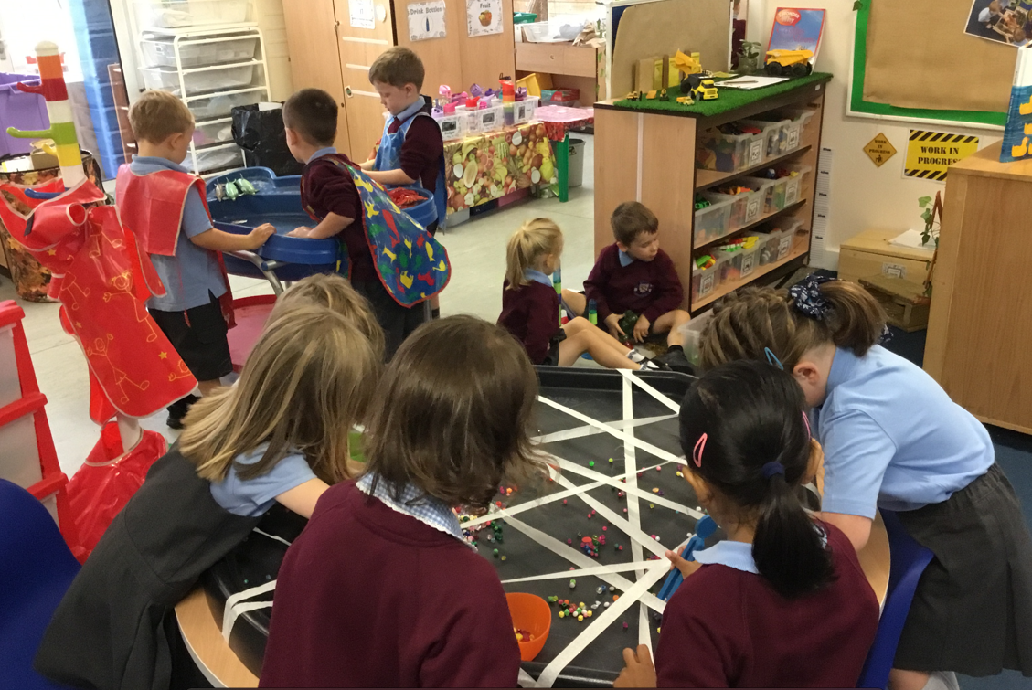
Prime Areas
2
Curriculum
Physical Development
Personal, Social and Emotional Development
Communication and Language

Slide 7
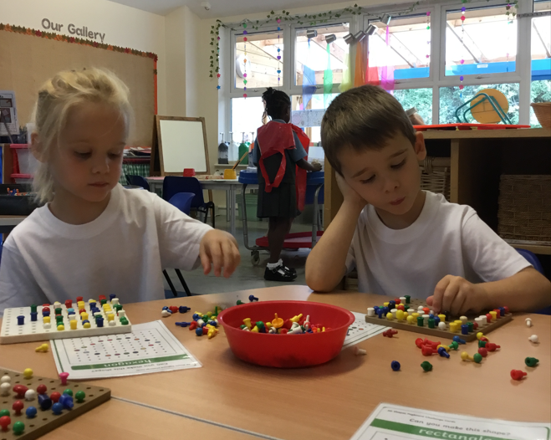
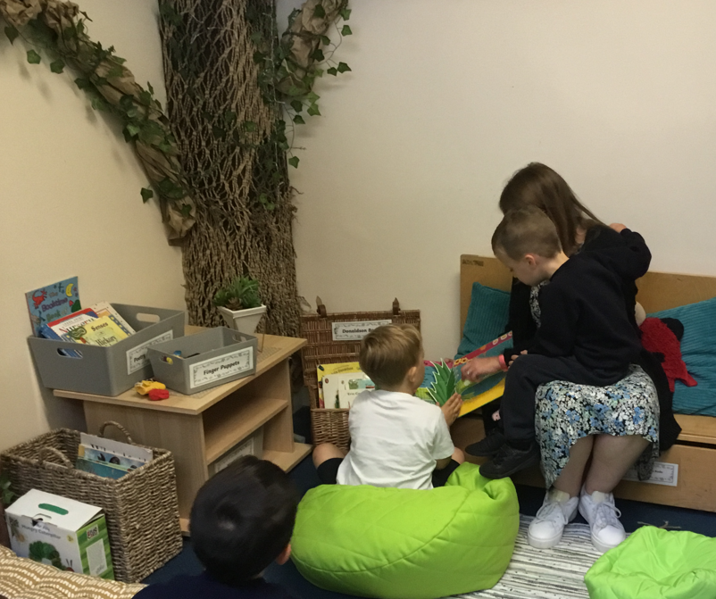
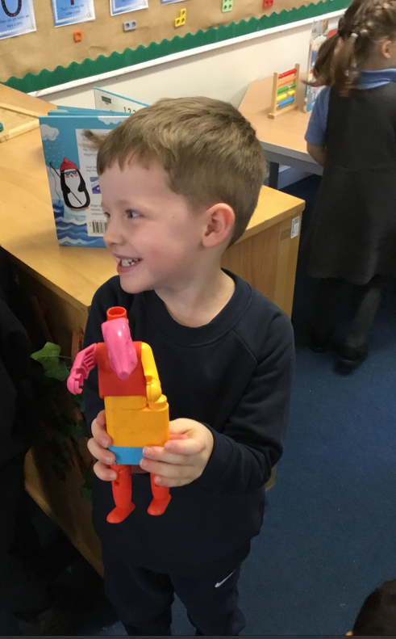
Specific Areas
2
Curriculum
Mathematics
Literacy
Expressive Art and Design
Understanding of the World

Slide 8
Our Topics
2
Curriculum
Amazing Autumn (Autumn Term Part 1)
Light and Dark (Autumn Term Part 2)
Traditional Stories (Spring Term Part 1)
Let’s Get Growing (Spring Term Part 2)
Special Journeys (Summer Term Part 1)
Amazing Animals (Summer Term Part 2)

Slide 9
Timetable
3
Timetable
8:40 – 9.00 | 9:00-9.20 | 9:20 – 10.30 | 10.30 | 10.45-11.00 | 11.00-11.25 | 11.25 | 11:30 - 11:40
Self Registration Disco Dough | Welcome song Phonics Phonics RWI Set 1 speed sounds | Choosing Time (inside/Outside) | Snacks are put out | Carpet Input - Literacy focus | Choosing Time (Inside) | Tidy up | Story/ movement break Lunch preparation
Lunch in the hall and then outside play time 11.45-12.45
12.45 - 1.00 | 1.00 - 1.45 | 1.45 - 2.00 | 2.00 - 2.30 | 2:45 - 3.10 | 3.10 - 3.15
Carpet input Maths | Choosing Time (inside) | Carpet Time Topic | Choosing Time (Outside) | Tidy up time Home Preperation Story time | Begin to dismiss

Slide 10
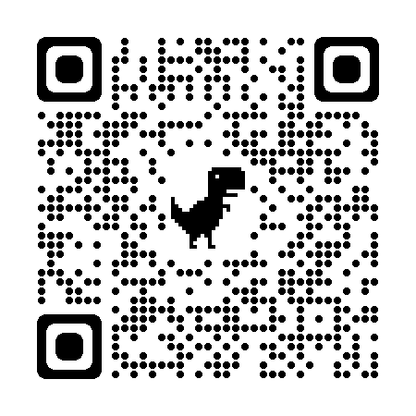

Phonics
4
Phonics
Read Write Inc is the UK’s leading synthetic phonics programme, which enables children to read and write.
Scan the QR code
https://www.youtube.com/watch?v=sjlPILhk7bQ

Slide 11

Phonics
4
Phonics
Speed sounds set 1 and 2.

Slide 12
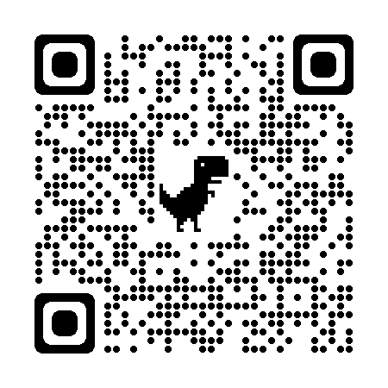
Phonics
4
Phonics
It is vital that we teach our children to pronounce the sounds correctly.
We call these Pure Sounds. Scan the QR code to hear the sounds.
https://www.youtube.com/watch?v=TkXcabDUg7Q

Slide 13
Phonics
4
Phonics
Speed sounds set 1 and 2.

Slide 14
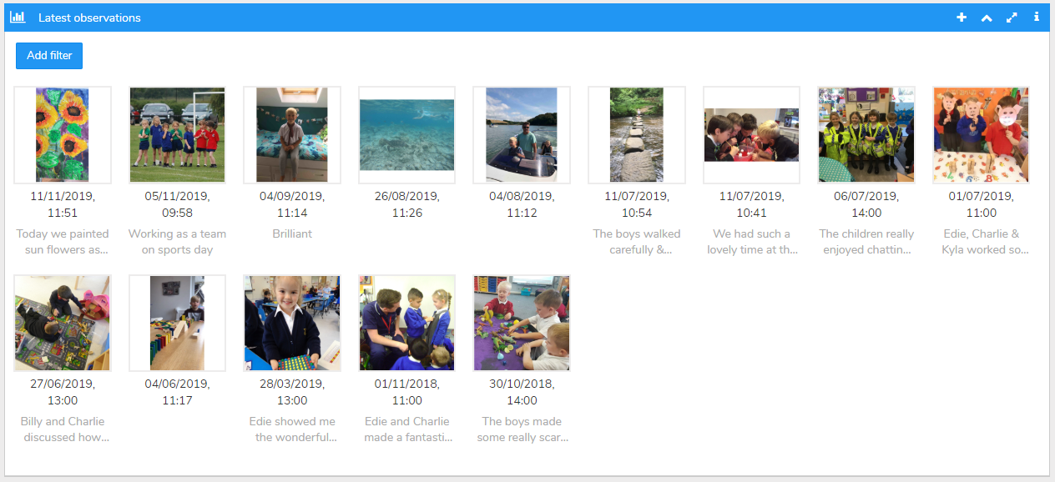
Evidence Me
5
Evidence me
Evidence Me is our virtual learning platform. This is what we use in class to communicate information via messages and reminders as well as information on how to support your child at home.
This is also an essential tool for you to see and respond to what your child is doing in the classroom as their observations will be uploaded to their profile and sent out to you on a regular basis.
This platform also offers you the opportunity to upload observations of learning that is taking place at home.

Slide 15
Dates for your diary
6
Key dates
Reading cafe every Friday from 8:40 - 9:00 (starting after half term)
Half Term Week beginning 28th October
INSET Day 4th November
Parents evening on 6th and 7th November
7th November- Individual Imago photos

Slide 16
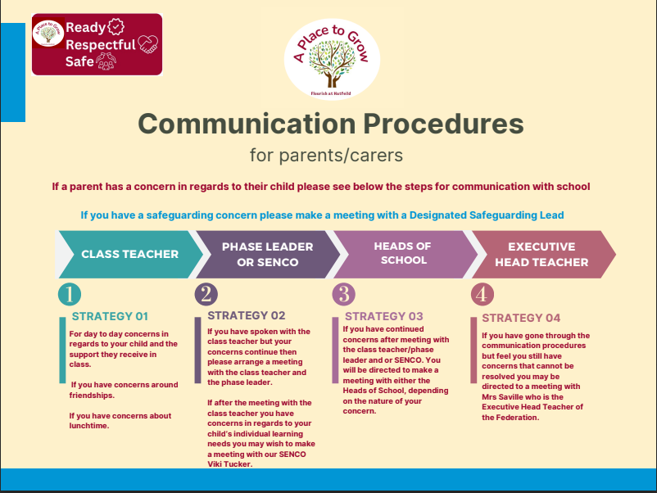
Communication
7

Slide 17
Parent Workshops -
18/10/2024 - Parent/Carer Workshop - Staying Safe Online @9am
04/10/2024 - Early Independence Workshop for EYFS Parents/Carers @9am
10/01/2025 - EYFS, KS1 & ARP - Phonics @9am
15/01/2025 - Early Reading @9am
28/01/20245 - Maths at Hatfeild @9am

Slide 18


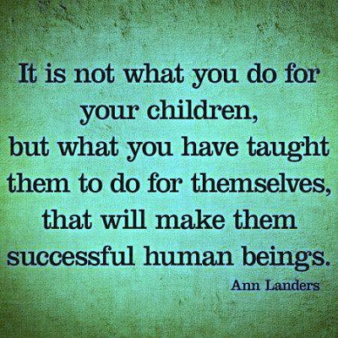
Lastly…..
Lastly
.

